Slide 1
MGS 723: Geodynamics
Class 10: Viscous deformation III
Main reference for today: Turcotte & Schubert, 2nd Ed., Sects. 7-3, 7-4

Slide 2
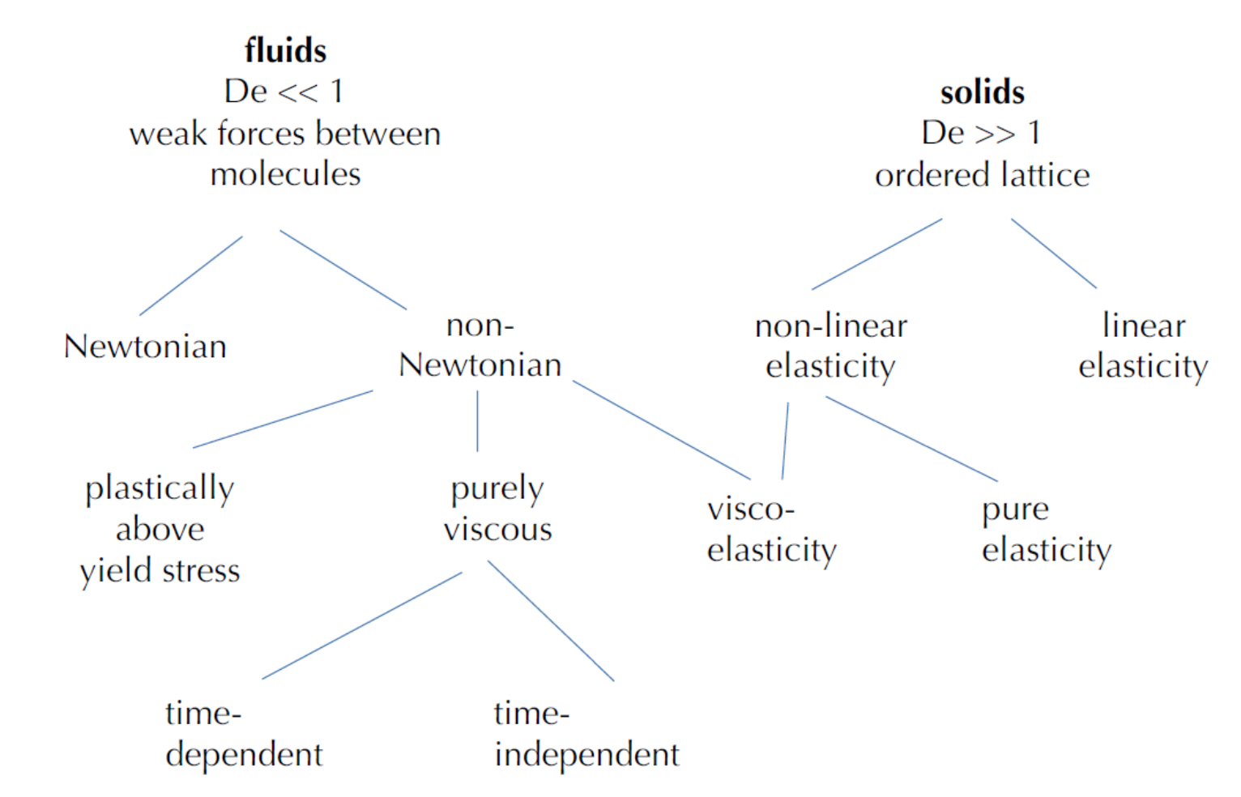
What about fluids?
Viscous flow
Becker and Faccenna

Slide 3
What about fluids?
Viscous flow
[At high temperature,
high pressure]

Slide 4
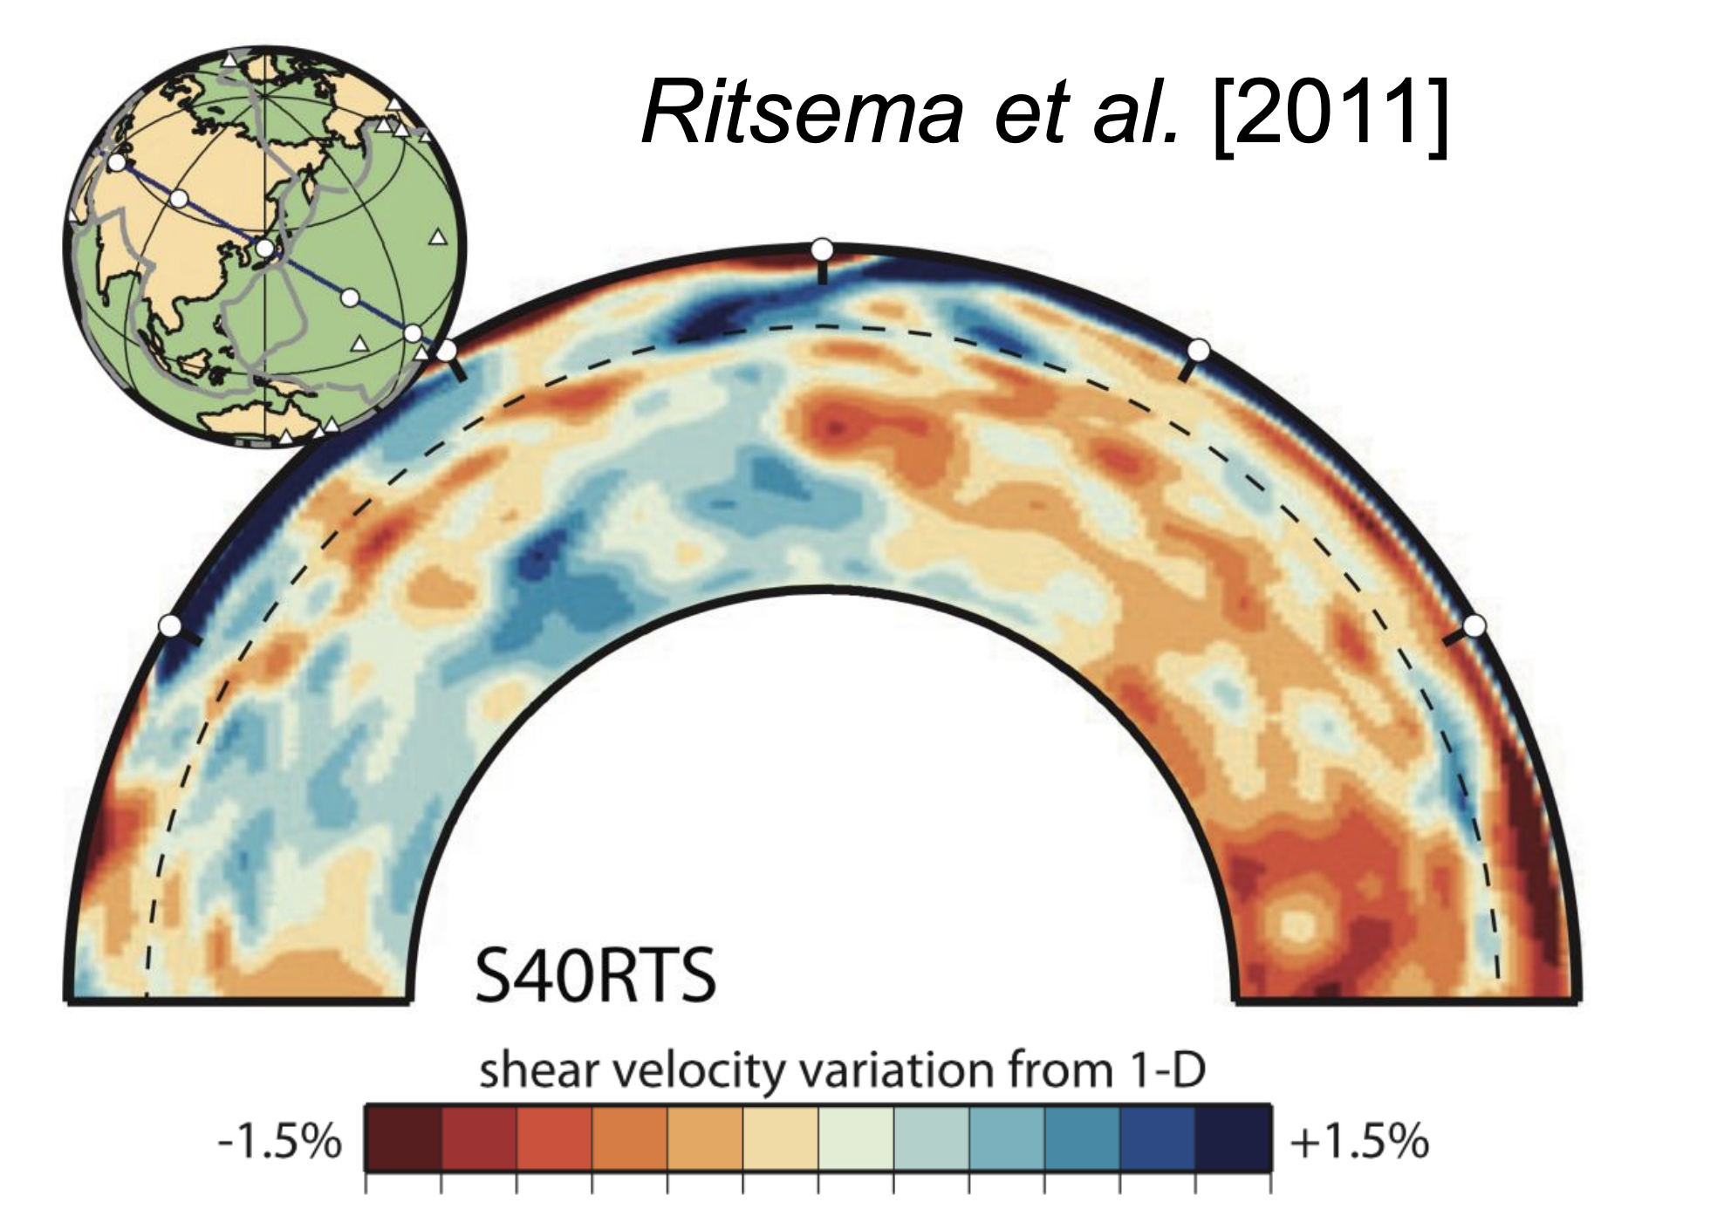
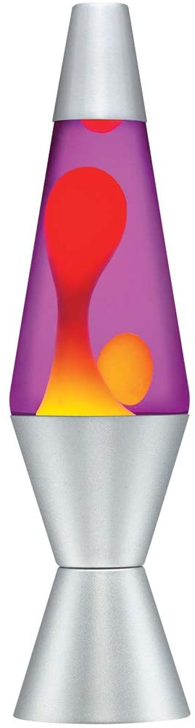
Viscous flow in the mantle

Slide 5
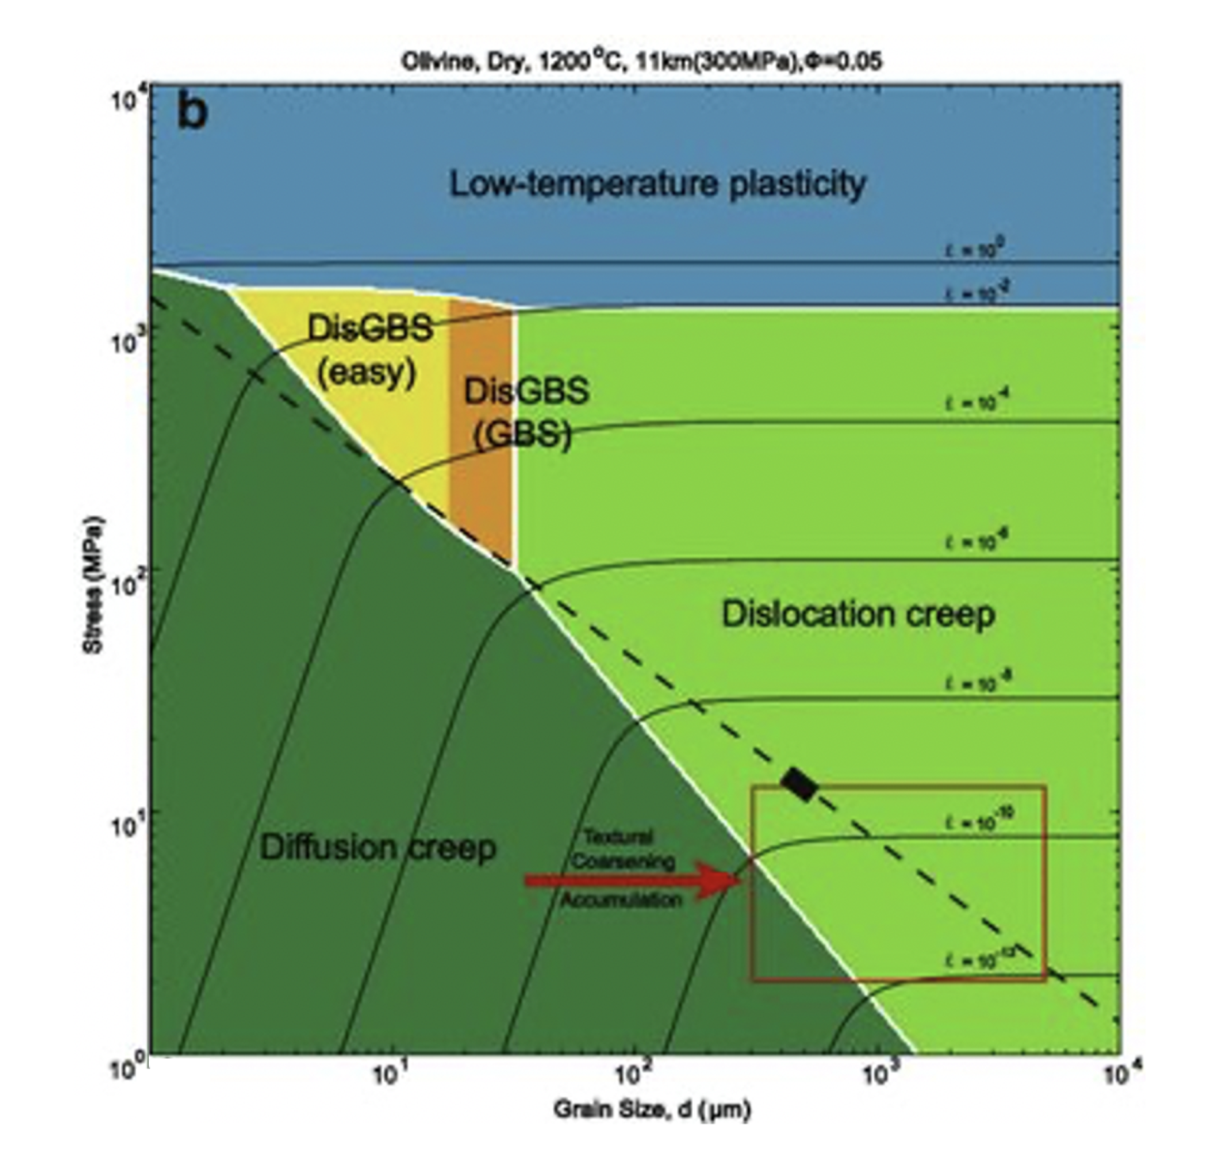
Viscous flow in the mantle: a deformation map
Zhuosen et al., 2017

Slide 6
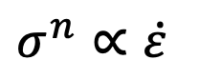
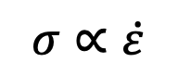
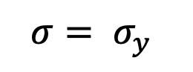
Viscous flow in the mantle: a deformation map
Zhuosen et al., 2017
$$σ= σ_{y}$$
$$σ^{n}∝\dot{ε}$$
$$σ∝\dot{ε}$$

Slide 7
Viscous flow in the mantle: a deformation map
Zhuosen et al., 2017
$$σ= σ_{y}$$
$$σ^{n}∝\dot{ε}$$
$$σ∝\dot{ε}$$

Slide 8
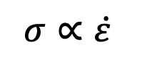
Diffusion creep
Diffusion of atoms through the interiors of crystal grains when the grains are subjected to stress.
As a result of this, the grains deform leading to strain.
Produces Newtonian fluid behavior:
$$σ∝\dot{ε}$$

Slide 9
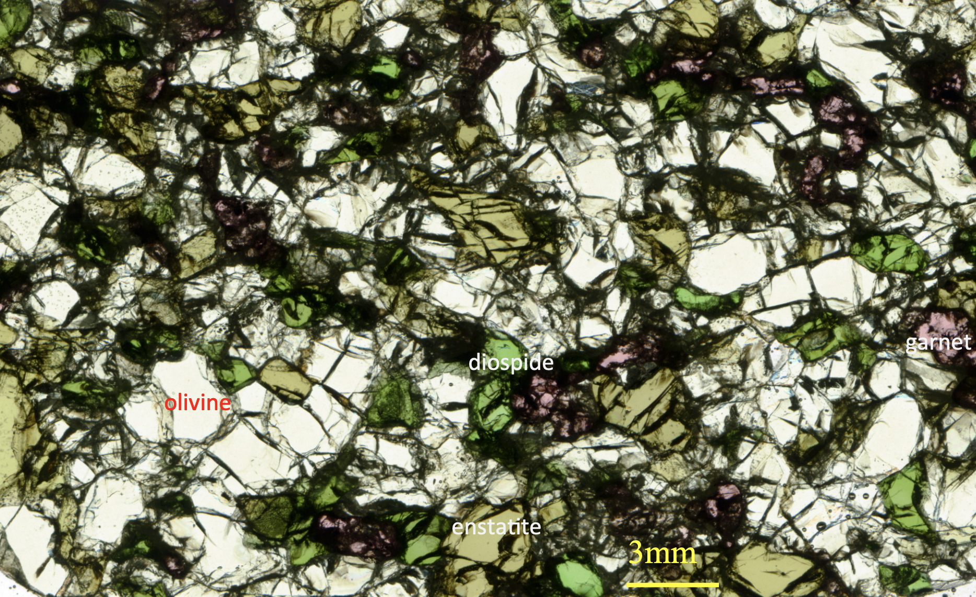
Diffusion creep
Diffusion of atoms through the interiors of crystal grains when the grains are subjected to stress.
As a result of this, the grains deform leading to strain.
Produces Newtonian fluid behavior:
$$σ∝\dot{ε}$$
In the mantle, olivine rich rocks (e.g., peridotite above) undergo diffusion creep

Slide 10
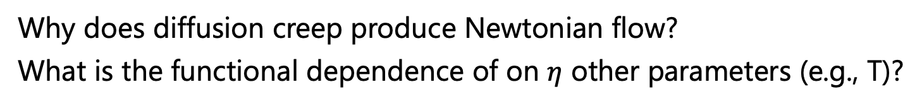
Diffusion creep
Why does diffusion creep produce Newtonian flow?
What is the functional dependence of on $η$ other parameters (e.g., T)?

Slide 11
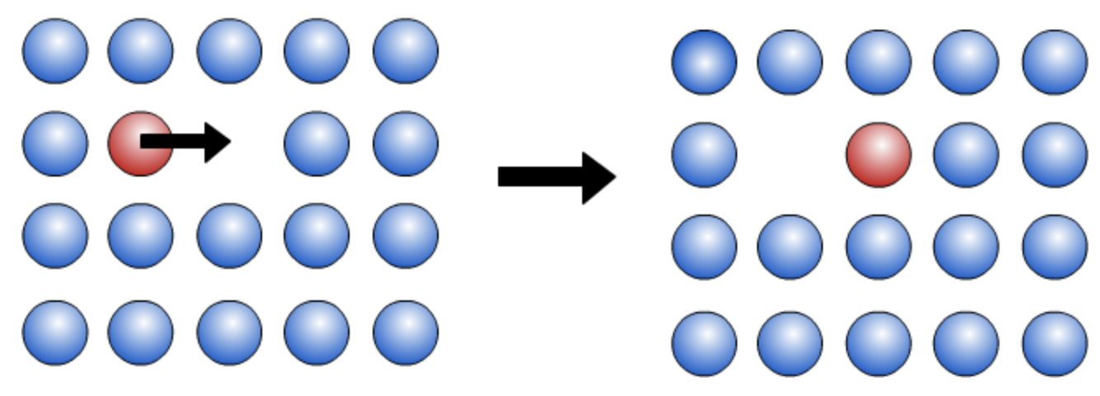
Diffusion creep
Why does diffusion creep produce Newtonian flow?
What is the functional dependence of on $η$ other parameters (e.g., T)?
Diffusion of an atom into a vacancy (= an empty lattice site = a point defect )

Slide 12
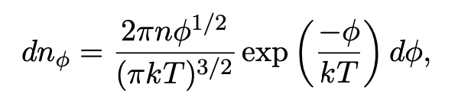
Diffusion creep
Why does diffusion creep produce Newtonian flow?
What is the functional dependence of on $η$ other parameters (e.g., T)?
Diffusion of an atom into a vacancy (= an empty lattice site = a point defect )
Maxwell-Boltzmann distribution for number of atoms with $∅$< kinetic energy < $∅$+d$∅$
k = Boltzmann constant = 1.381e-23 J/K
Notes:
Mean kinetic energy associated with thermal motions of atoms in a crystal lattice = 3/2 kT (per atom – i.e, ½ kT in three vibrational directions)

Slide 13
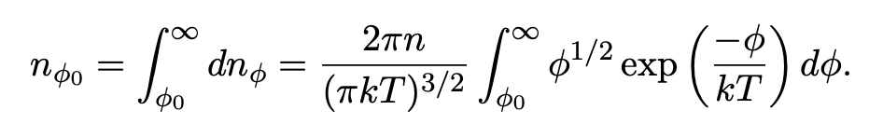
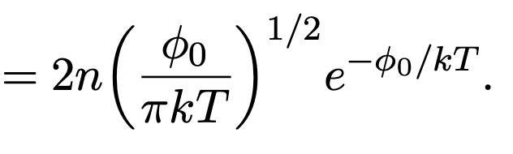
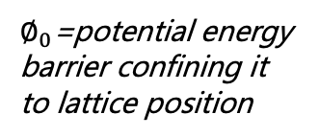

Diffusion creep
Why does diffusion creep produce Newtonian flow?
What is the functional dependence of on $η$ other parameters (e.g., T)?
Diffusion of an atom into a vacancy (= an empty lattice site = a point defect )
Maxwell-Boltzmann distribution for number of atoms with $∅$< kinetic energy < $∅$+d$∅$
k = Boltzmann constant = 1.381e-23 J/K
Number of atoms with kinetic energy > $∅_{0}:$
$∅_{0}$=potential energy barrier confining it to lattice position
$$≈$$

Slide 14
Diffusion creep
Why does diffusion creep produce Newtonian flow?
What is the functional dependence of on $η$ other parameters (e.g., T)?
Diffusion of an atom into a vacancy (= an empty lattice site = a point defect )
Maxwell-Boltzmann distribution for number of atoms with $∅$< kinetic energy < $∅$+d$∅$
k = Boltzmann constant = 1.381e-23 J/K
Number of atoms with kinetic energy > $∅_{0}:$
Highly T-dependent
$∅_{0}$=potential energy barrier confining it to lattice position
$$≈$$

Slide 15

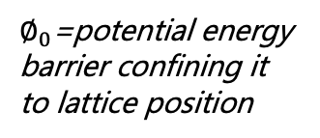
Diffusion creep
Number of atoms with kinetic energy > $∅_{0}:$
$∅_{0}$=potential energy barrier confining it to lattice position
$$≈$$

Slide 16
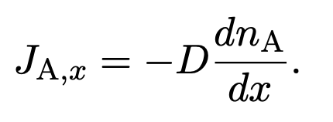
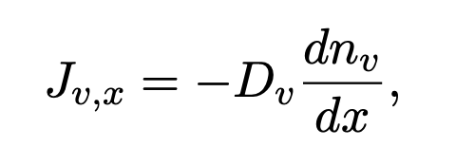
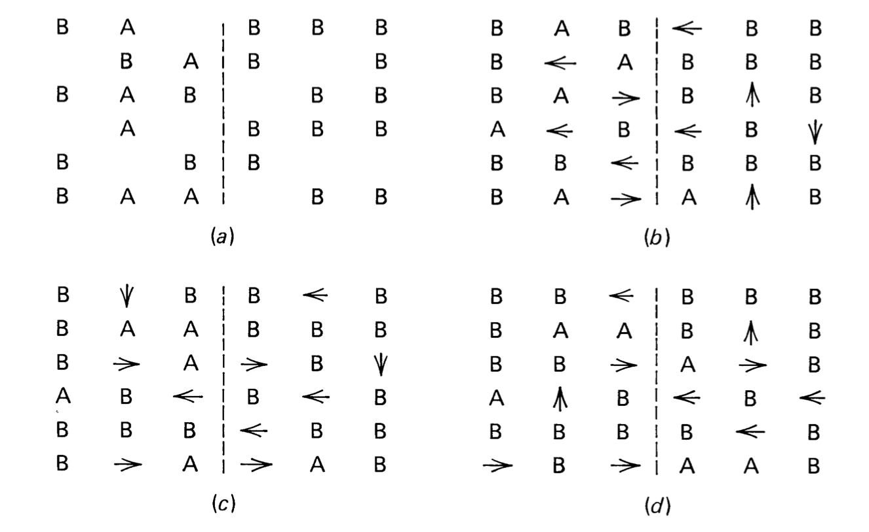
Diffusion creep
Number of atoms with kinetic energy > $∅_{0}:$
$∅_{0}$=potential energy barrier confining it to lattice position
$$≈$$
Flux of atoms (minor species = A) or vacancies (right):
Fick’s first law of diffusion (J = diffusion flux)
Notes:
Flux = rate of flow of atoms, per unit area

Slide 17
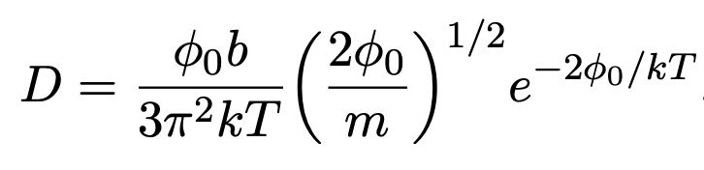
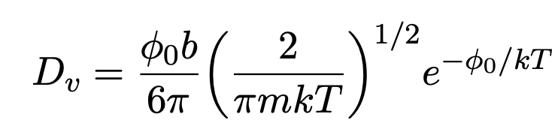
Diffusion creep
Number of atoms with kinetic energy > $∅_{0}:$
$∅_{0}$=potential energy barrier confining it to lattice position
$$≈$$
Flux of atoms (minor species = A) or vacancies (right):
Fick’s first law of diffusion (J = diffusion flux)
Incorporating the energy constraints, diffusion pre-factors become:
b = atom spacing
m = mass of atom

Slide 18
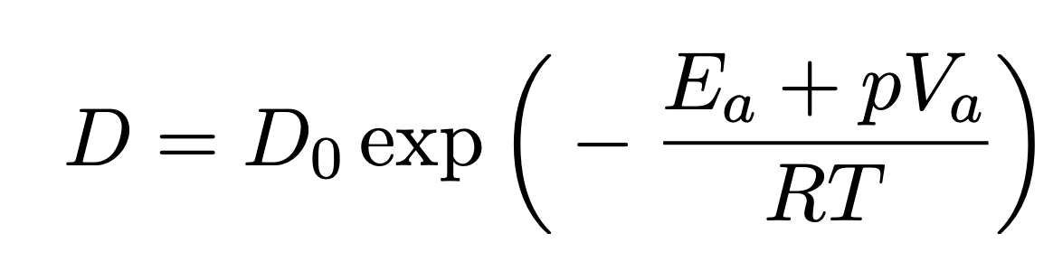
Diffusion creep
Number of atoms with kinetic energy > $∅_{0}:$
$∅_{0}$=potential energy barrier confining it to lattice position
$$≈$$
Flux of atoms (minor species = A) or vacancies (right):
Fick’s first law of diffusion (J = diffusion flux)
Incorporating the energy constraints, diffusion pre-factors become:
b = atom spacing
m = mass of atom
High temperature -> high diffusion
(high KE)
High pressure -> low diffusion
(reduces number of vacancies and increases potential energy barrier)
E_{a} = activation energy/mole
V_{a} = activation volume/mole
D₀ = frequency factor
R = gas constant (molar equivalent to Boltzmann const)

Slide 19
Diffusion creep
High temperature -> high diffusion
(high KE)
High pressure -> low diffusion
(reduces number of vacancies and increases potential energy barrier)

Slide 20
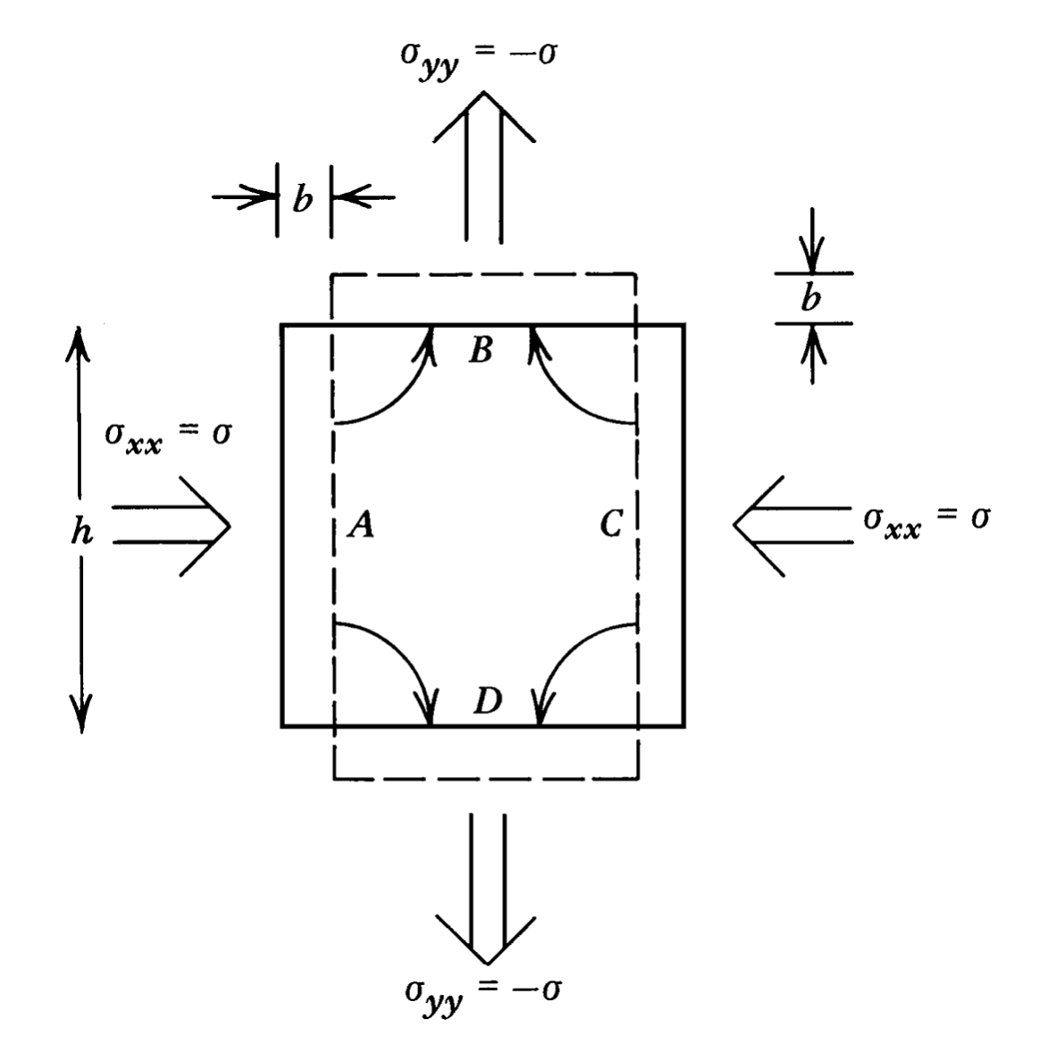
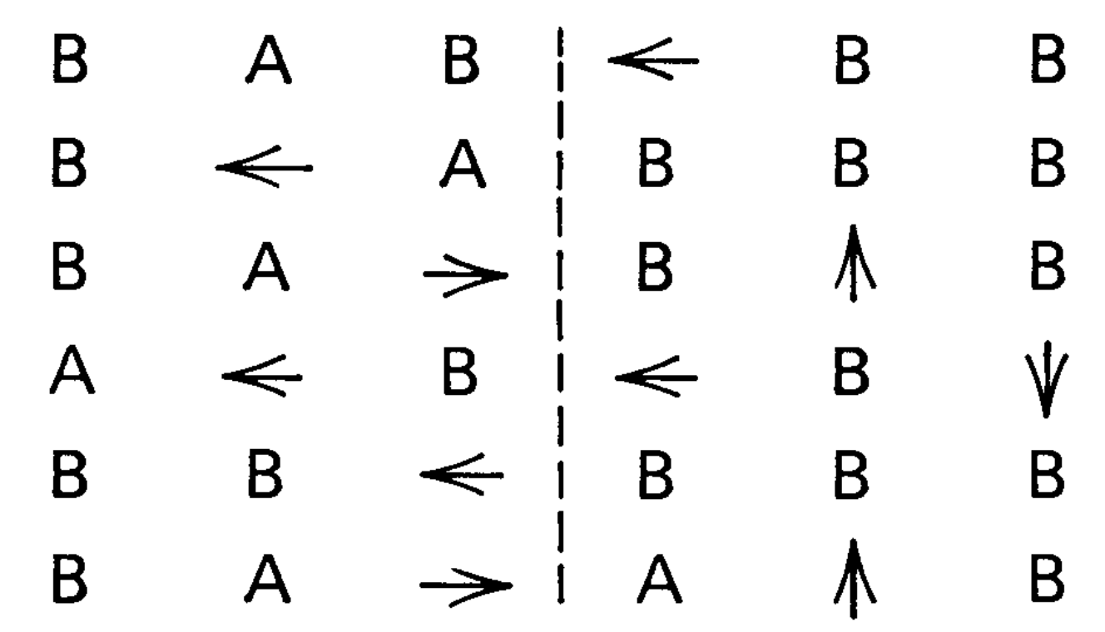
Diffusion creep
Diffusion under stress? (i.e., why does it produce $σ∝\dot{ε}$?)
A atoms,
B atoms, vacancies
Notes:
b = atom spacing, h = grain size

Slide 21
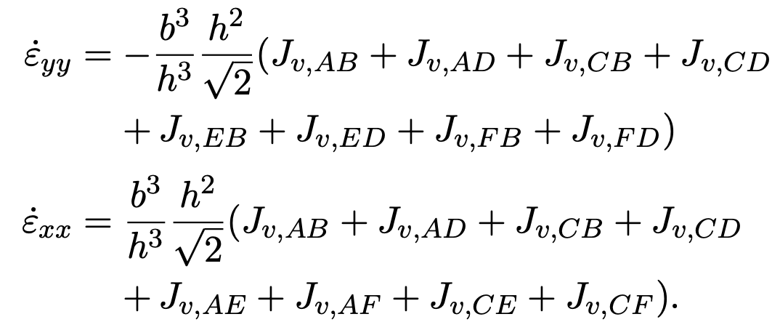
Diffusion creep
Diffusion under stress? (i.e., why does it produce $σ∝\dot{ε}$?)
A atoms,
B atoms, vacancies
Notes:
b = atom spacing, h = grain size

Slide 22
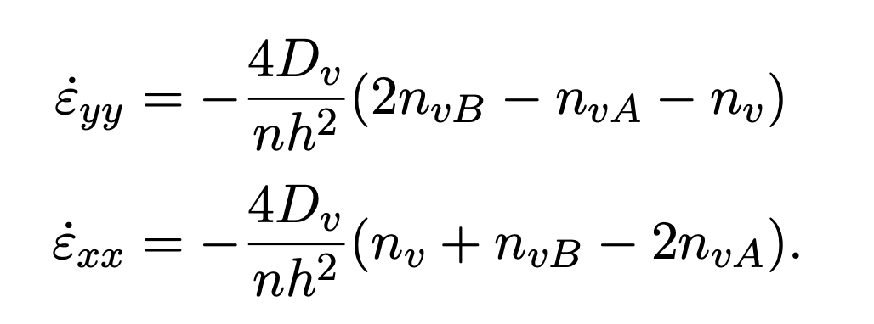
Diffusion creep
Diffusion under stress? (i.e., why does it produce $σ∝\dot{ε}$?)
A atoms,
B atoms, vacancies
Can relate strain rate to vacancy flux and hence number of atoms/vacancies (per unit volume)
Notes:
b = atom spacing, h = grain size

Slide 23
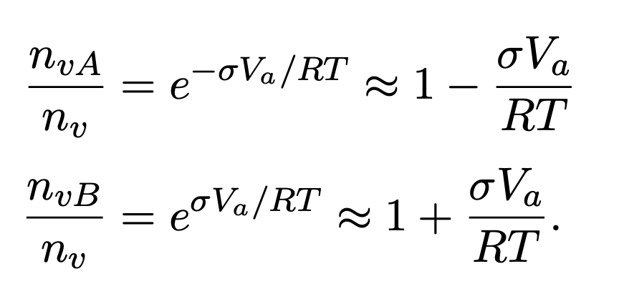
Diffusion creep
Diffusion under stress? (i.e., why does it produce $σ∝\dot{ε}$?)
A atoms,
B atoms, vacancies
Bringing in stress:
Can also relate stress to number of vacancies for each species
Notes:
b = atom spacing, h = grain size

Slide 24
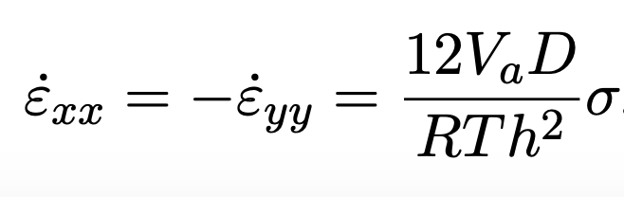
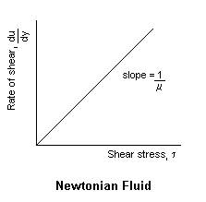
Diffusion creep
Diffusion under stress? (i.e., why does it produce $σ∝\dot{ε}$?)
A atoms,
B atoms, vacancies
linear stress-strain rate relationship!
Bringing in stress:
Can also relate stress to number of vacancies for each species
Notes:
b = atom spacing, h = grain size

Slide 25
Diffusion creep
linear stress-strain rate relationship!

Slide 26
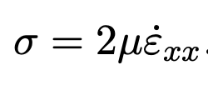
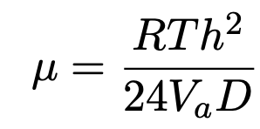
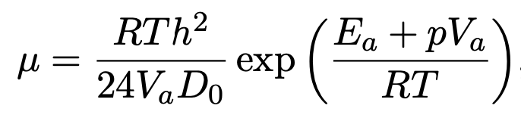
Diffusion creep
linear stress-strain rate relationship!
Following , can rearrange to provide a viscosity and substitute for D:
We have a
flow law!
(Newtonian)
Diffusion creep viscosity is Newtonian, strongly temperature and pressure dependent. Also includes a grain size, h, dependence.

Slide 27
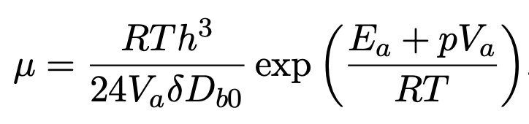
Diffusion creep
linear stress-strain rate relationship!
Following , can rearrange to provide a viscosity and substitute for D:
We have a
flow law!
(Newtonian)
Diffusion creep viscosity is Newtonian, strongly temperature and pressure dependent. Also includes a grain size, h, dependence.
If diffusion occurs dominantly along grain boundaries (i.e., not in grain interiors), very similar functional form:
We have a
flow law!
(Newtonian)
Notes:
H = grain size

Slide 28
Dislocation creep
The other main type of high-T, high-P fluid deformation of mantle material (often consider pure olivine as a simplification).
Deformation occurs via the migration of dislocations (planes of atoms)

Slide 29
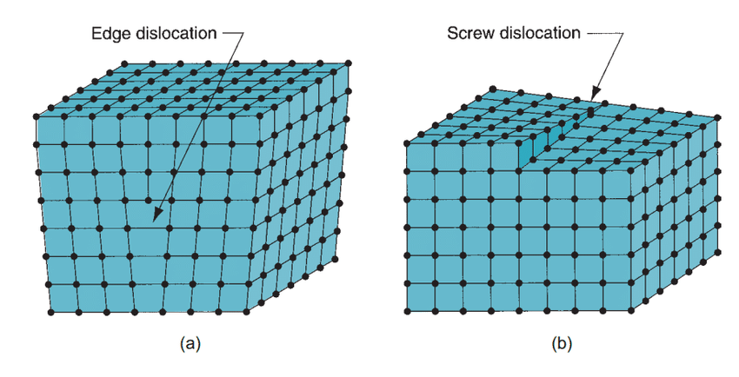
Dislocation creep
The other main type of high-T, high-P fluid deformation of mantle material (often consider pure olivine as a simplification).
Deformation occurs via the migration of dislocations (planes of atoms)
Dislocations = linear imperfections in the crystal lattice structure
Two main types: Screw and edge

Slide 30
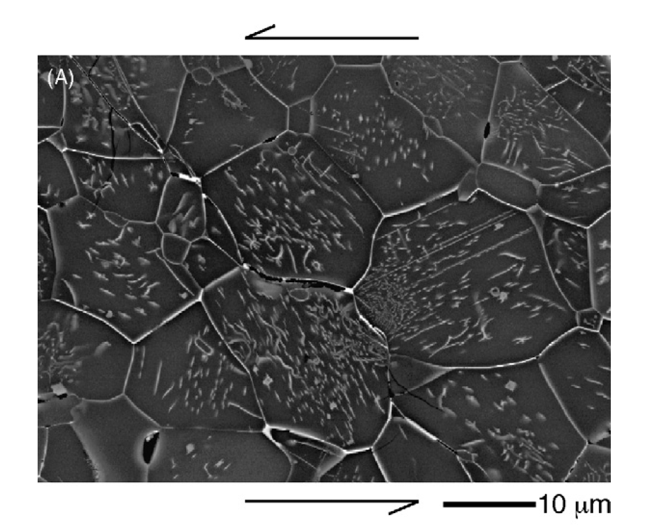
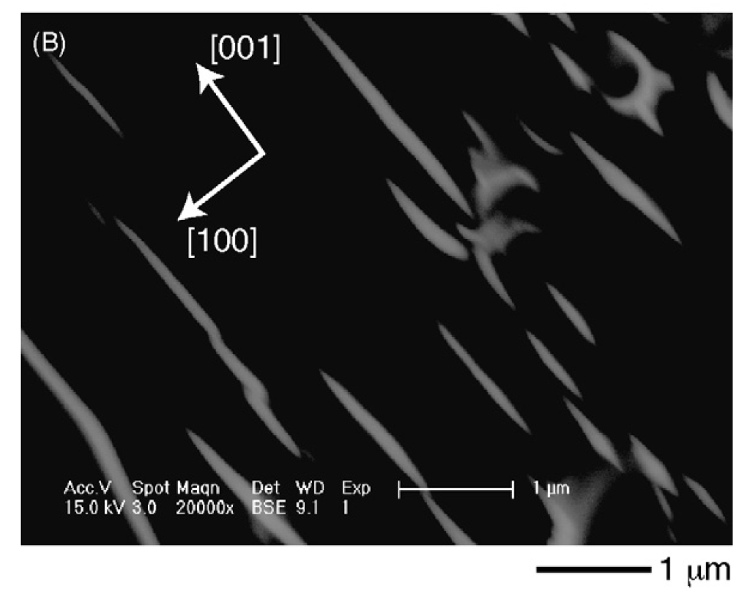
Dislocation creep
The other main type of high-T, high-P fluid deformation of mantle material (often consider pure olivine as a simplification).
Deformation occurs via the migration of dislocations (planes of atoms)
Dislocations = linear imperfections in the crystal lattice structure
Katayama and Karato, 2008, PEPI
backscattered electron image

Slide 31
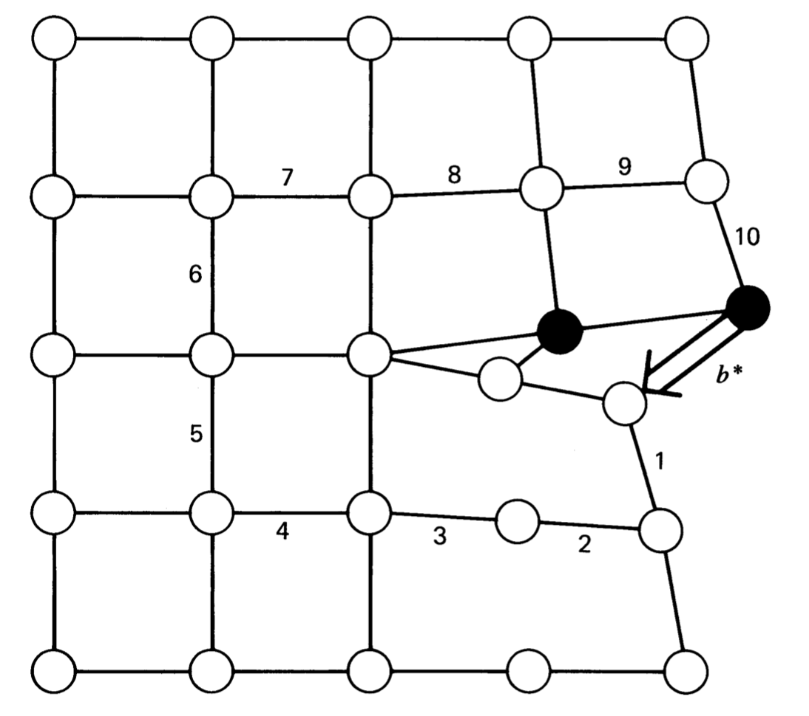
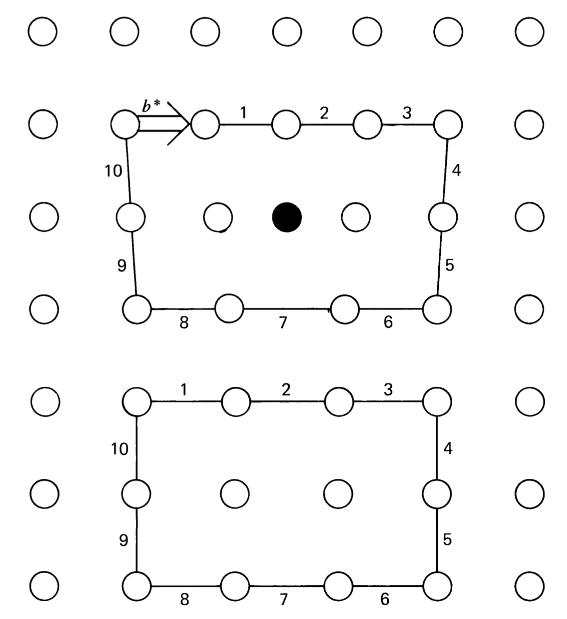
Dislocation creep
Side view of a screw dislocation. Note that the deformed atoms (solid circles) are out of the plane
Side view of an edge dislocation in a cubic lattice. The edge dislocation (solid circle) in perpendicular to the plane of figure.

Slide 32
Dislocation creep
Side view of a screw dislocation. Note that the deformed atoms (solid circles) are out of the plane
Side view of an edge dislocation in a cubic lattice. The edge dislocation (solid circle) in perpendicular to the plane of figure.
b* = Burger’s vector
The amount of atom motion (slip) that occurs as the dislocation moves through the lattice, determined using a Burger‘s circuit.

Slide 33
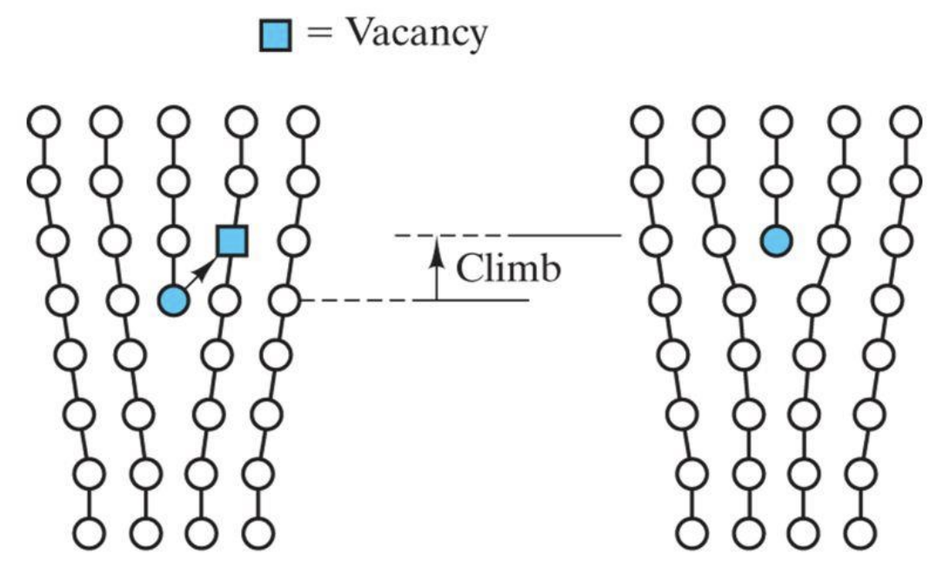
Dislocation creep occurs as dislocations migrate
Two main ways:
Dislocation climb:
Lengthening or shortening of the dislocation (i.e., the extra plane of atoms)

Slide 34
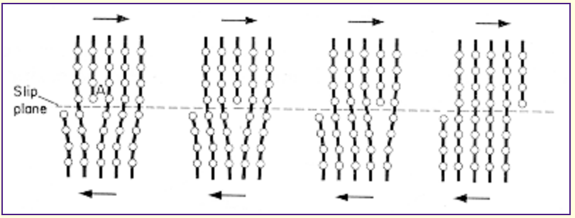
Dislocation creep occurs as dislocations migrate
Two main ways:
Dislocation climb:
Lengthening or shortening of the dislocation (i.e., the extra plane of atoms)
Dislocation slip:
Transfer of an edge location to adjacent plane of atoms due to shear stress

Slide 35
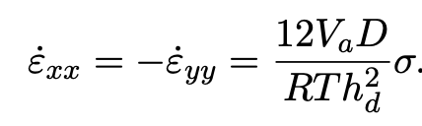
Dislocation creep
Coming up with a flow law:
Again, thermally activated (exponentially dependent on pressure and inverse of temperature)
Assuming dislocations act as sources and sinks of vacancies (i.e., just as in diffusion creep), we again have:
Where grain size, h, has been replaced by the average distance between dislocations, h_{d}

Slide 36
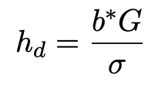
Dislocation creep
Coming up with a flow law:
Again, thermally activated (exponentially dependent on pressure and inverse of temperature)
Assuming dislocations act as sources and sinks of vacancies (i.e., just as in diffusion creep), we again have:
Where grain size, h, has been replaced by the average distance between dislocations, h_{d}
However, we now introduce another stress dependence as dislocation density depends on stress field:
G = shear mod.
b* = Burgers vect.

Slide 37
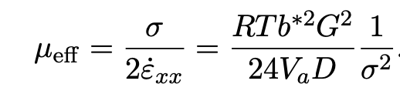
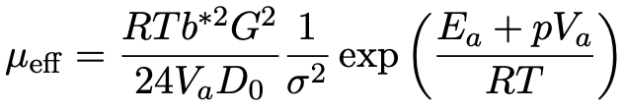
Dislocation creep
Coming up with a flow law:
Again, thermally activated (exponentially dependent on pressure and inverse of temperature)
Assuming dislocations act as sources and sinks of vacancies (i.e., just as in diffusion creep), we again have:
Where grain size, h, has been replaced by the average distance between dislocations, h_{d}
However, we now introduce another stress dependence as dislocation density depends on stress field:
Which produces the following viscosity expression (flow law):
G = shear mod.
b* = Burgers vect.
We have a flow law! (Non-Newtonian with n = 3)

Slide 38
Dislocation creep
Coming up with a flow law:
Again, thermally activated (exponentially dependent on pressure and inverse of temperature)
Assuming dislocations act as sources and sinks of vacancies (i.e., just as in diffusion creep), we again have:
Where grain size, h, has been replaced by the average distance between dislocations, h_{d}
However, we now introduce another stress dependence as dislocation density depends on stress field:
Which produces the following viscosity expression (flow law):
G = shear mod.
b* = Burgers vect.
No grain size dependence!
We have a flow law! (Non-Newtonian with n = 3)

Slide 39

Dislocation creep
Many other theoretical models
for dislocation creep, e.g.:
Subgrain boundary recovery model: n = 3
Weertman model: n =3 or 3.5 (depending on assumptions)
Nabarro model: n =3
Dislocation creep: Chapter 9

Slide 40
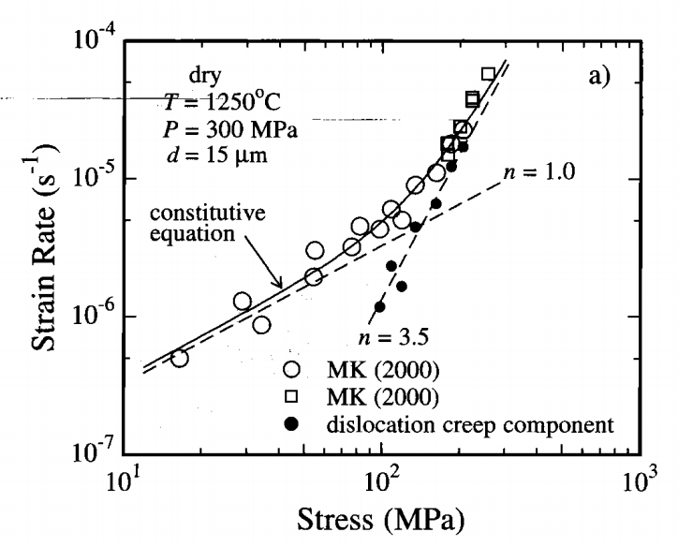
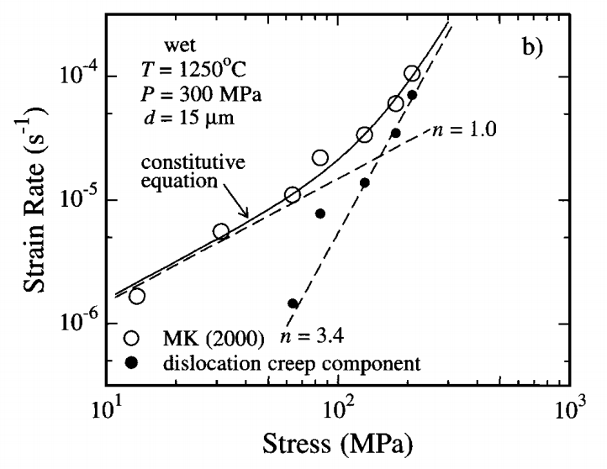
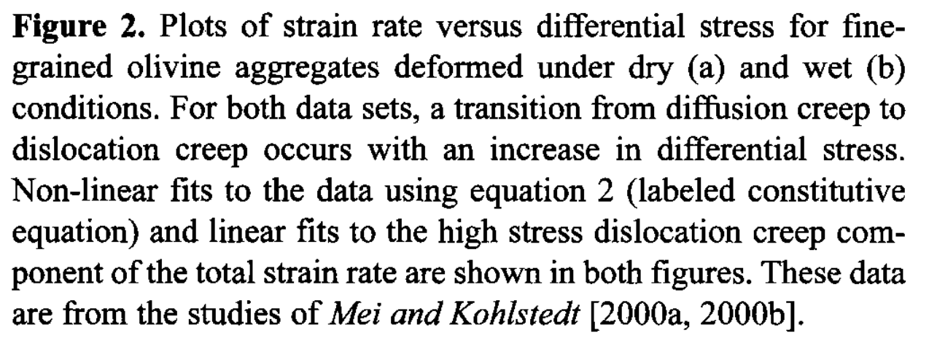
Dislocation creep: Figuring out the parameters…
Experiments:
Hirth and Kohlstedt, 2003: http://www.soest.hawaii.edu/GG/FACULTY/smithkonter/GG631/other/HirthKohlstedt_2000.pdf

Slide 41
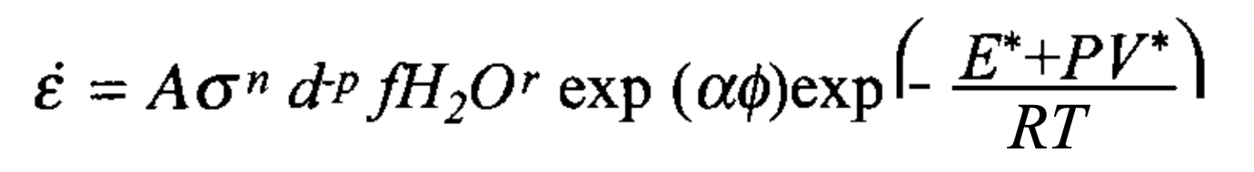
Dislocation and diffusion creep
Result: A generic flow law to describe olivine diffusion and dislocation creep:
Hirth and Kohlstedt, 2003: http://www.soest.hawaii.edu/GG/FACULTY/smithkonter/GG631/other/HirthKohlstedt_2000.pdf

Slide 42
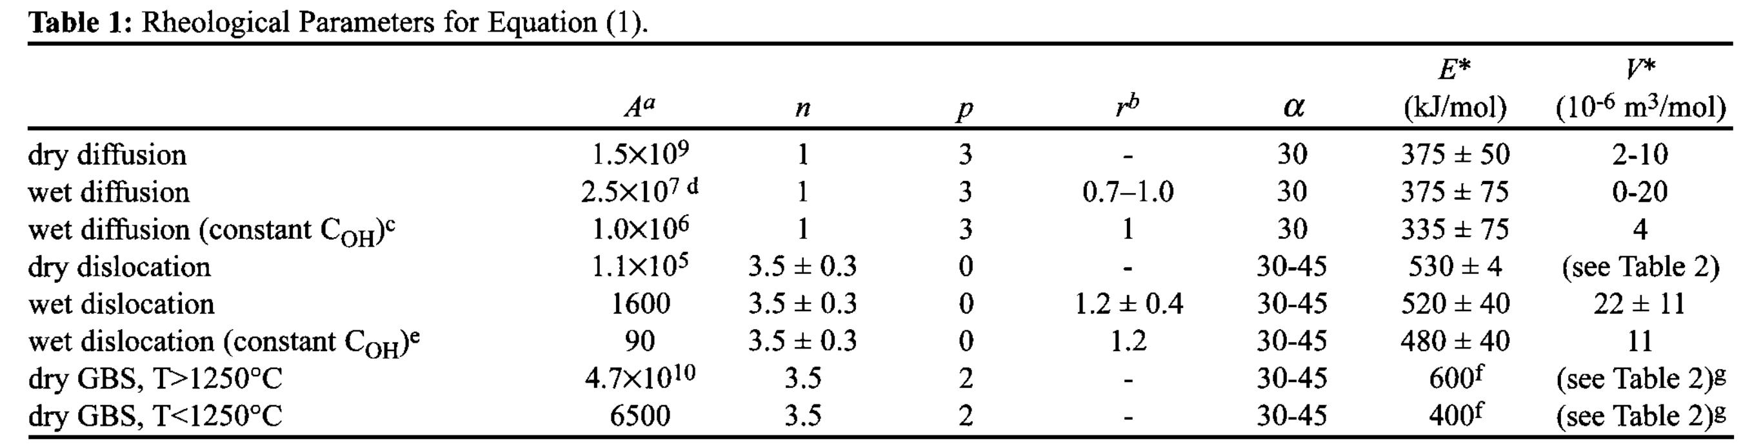
Dislocation and diffusion creep
Result: A generic flow law to describe olivine diffusion and dislocation creep:
Hirth and Kohlstedt, 2003: http://www.soest.hawaii.edu/GG/FACULTY/smithkonter/GG631/other/HirthKohlstedt_2000.pdf

Slide 43

Dislocation and diffusion creep
Result: A generic flow law to describe olivine diffusion and dislocation creep:
Note:
n = 1 for diffusion creep (Newtonian), n $≈$ 3.5 for dislocation creep.
No grain size dependence for dislocation creep (p = 0)
Hirth and Kohlstedt, 2003: http://www.soest.hawaii.edu/GG/FACULTY/smithkonter/GG631/other/HirthKohlstedt_2000.pdf

Slide 44
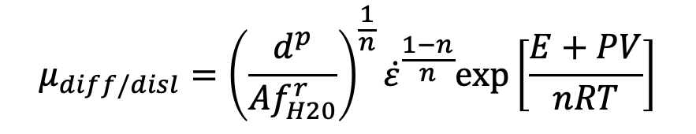
Dislocation and diffusion creep
Result: A generic flow law to describe olivine diffusion and dislocation creep:
Following , can also re-arrange to get an effective viscosity
Both deformation mechanisms will typically be active at the same time.
$$μ_{diff/disl}={\left(\frac{d^{p}}{Af_{H20}^{r}}\right)}^{\frac{1}{n}}{\dot{ε}}^{\frac{1−n}{n}}exp⁡\left[\frac{E+PV}{nRT}\right]$$
Note:
melt now neglected

Slide 45

Dislocation and diffusion creep
Result: A generic flow law to describe olivine diffusion and dislocation creep:
Following , can also re-arrange to get an effective viscosity
Both deformation mechanisms will typically be active at the same time.
$$μ_{diff/disl}={\left(\frac{d^{p}}{Af_{H20}^{r}}\right)}^{\frac{1}{n}}{\dot{ε}}^{\frac{1−n}{n}}exp⁡\left[\frac{E+PV}{nRT}\right]$$
Note:
melt now neglected

Slide 46


Dislocation and diffusion creep
Result: A generic flow law to describe olivine diffusion and dislocation creep:
Following , can also re-arrange to get an effective viscosity
Both deformation mechanisms will typically be active at the same time.
$$μ_{diff/disl}={\left(\frac{d^{p}}{Af_{H20}^{r}}\right)}^{\frac{1}{n}}{\dot{ε}}^{\frac{1−n}{n}}exp⁡\left[\frac{E+PV}{nRT}\right]$$
Note:
melt now neglected
$$\frac{1}{μ_{eff}}=\frac{1}{μ_{diff}}+⁡\frac{1}{μ_{disl}}$$
$μ_{comp}$= composite viscosity (dominated by weakest phase!)

Slide 47

Dislocation and diffusion creep and …
Result: A generic flow law to describe olivine diffusion and dislocation creep:
Following , can also re-arrange to get an effective viscosity
Both deformation mechanisms will typically be active at the same time.
$$μ_{diff/disl}={\left(\frac{d^{p}}{Af_{H20}^{r}}\right)}^{\frac{1}{n}}{\dot{ε}}^{\frac{1−n}{n}}exp⁡\left[\frac{E+PV}{nRT}\right]$$
Note:
melt now neglected
$$\frac{1}{μ_{eff}}=\frac{1}{μ_{diff}}+\frac{1}{μ_{diff}}+⁡\frac{1}{μ_{Peierls}}$$
And can consider other deformation styles (e.g., Low-T plasticity)

Slide 48

Dislocation and diffusion creep and …
A deformation map for olivine under dry conditions
Karato, 2008

Slide 49
Dislocation and diffusion creep and …
Peierls mechanism/creep:
Deviations from power-law relationship at high stress.
Strain rates increase more rapidly than power-law predicts.
This occurs at a threshold stress: Peierls stress.
Peierls stress analogous to yield stress. I.e., strength is limited to this threshold stress and strain rates become unbounded.
[See, e.g., Karato (2008) for mechanistic explanation]
Karato, 2008

Slide 50
Dislocation and diffusion creep and …
A deformation map for olivine under dry conditions
Ductile flow in the upper mantle: diffusion creep, dislocation creep, Peierls creep.
Peierls creep important at high stress and/or low T (slabs?)
Diffusion-dislocation creep boundary is close to avg. upper mantle conditions. Both dominant in different regions (e.g., slight reduction in grain size could cause switch from disl. to diff. creep).
Karato, 2008

Slide 51

Deformation in the lithosphere
Today's discussion: Flow laws
Applies to depths > brittle-to-ductile transition
Above which, brittle and elastic rheologies dominate (i.e., are weaker and so dominate strain/strain rate).
https://blogs.egu.eu/divisions/gd/files/2017/10/Christmas.jpg

Slide 52

Deformation in the lithosphere
Here, many different rheological combinations possible (and applicable to different processes/scales)
Becker and Faccenna

Slide 53



Flow laws implemented within a subduction model
Garel et al., 2014, G³

Slide 54
Take homes:
Diffusion and dislocation creep dominant in a flowing upper mantle. Both thermally (kinetic energy) activated.
Diffusion creep: Newtonian, grain size (d ) dependance.
Dislocation creep: Non-Newtonian, no d dependance.
Additionally: Peirels creep (low-temp plasticity)
To determine which mechanism dominates (for given set of parameters): Calculate all viscosities, and the weakest one accommodates the deformation (i.e., dictates the composite viscosity).
Above the brittle-ductile transition, elasticity and brittle failure come into play (previous classes).

